Slide 2
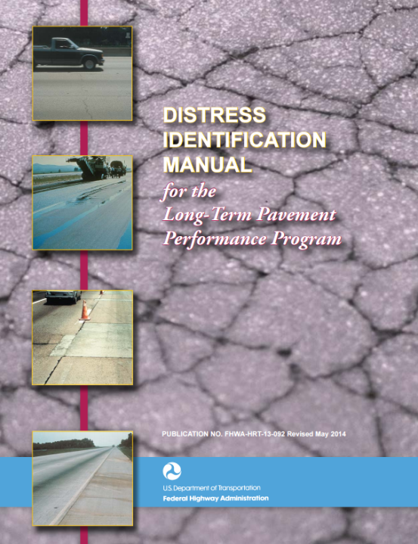
Comparison of Pavement Distresses Monitored by LTPP and State Agencies

Slide 3
Comparison of Pavement Distresses Monitored by LTPP and State Agencies
LTPP’s collection of pavement distresses were used in the initial calibration of the Mechanistic-Empirical Pavement Design Guide
Thus, it is important for states to compare their distress identification procedures and results with the LTPP distresses as part of the local calibration process.

Slide 4
Comparison of Pavement Distresses Monitored by LTPP and State Agencies
Obtain pavement distress data and the LTPP Distress Identification Manual from the Long Term Pavement Performance (LTPP) program using LTPP InfoPave, by the following steps..

Slide 5
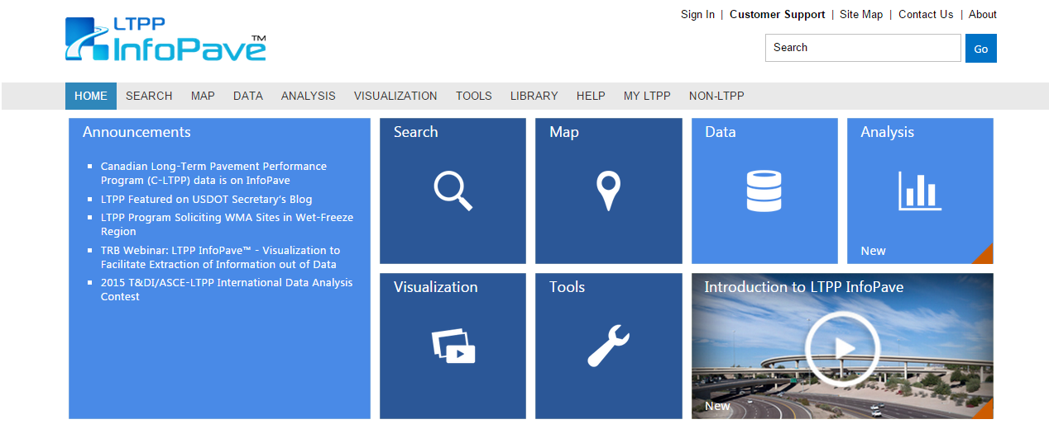
Pavement Distresses: Step 1...
www.InfoPave.com
Register or Sign in.

Slide 6
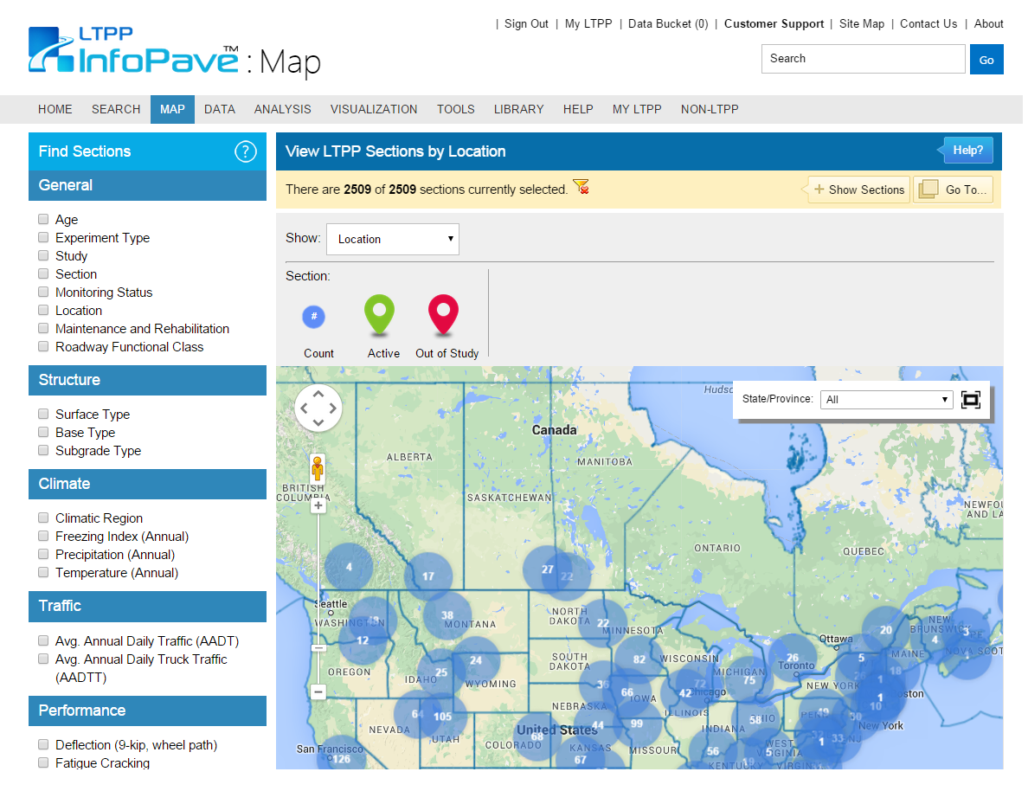
Pavement Distresses: Step 1...
www.InfoPave.com/Map/ByLocation/
Locate which sections pertain to your study.
Use filters to narrow search parameters.

Slide 7
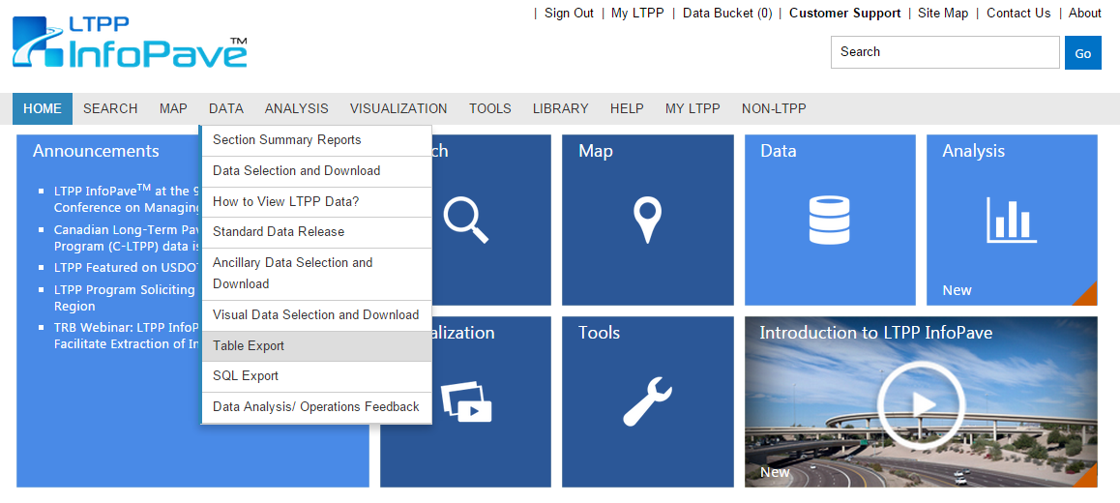
Pavement Distresses: Step 2
www.InfoPave.com/Data/
Go to: Data
Go to: Table Export

Slide 8
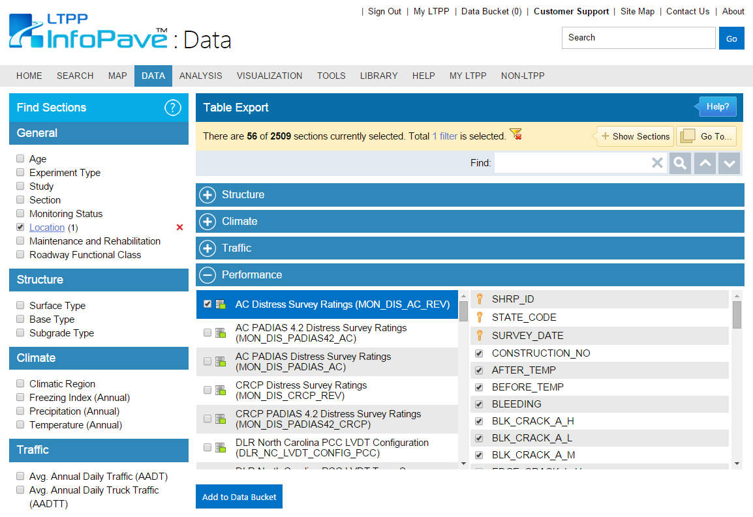
Pavement Distresses: Step 2...
http://www.infopave.com/Data/TableExport/
Expand “Performance” tab and select relevant distress data.
Click “Add to Data Bucket”

Slide 9
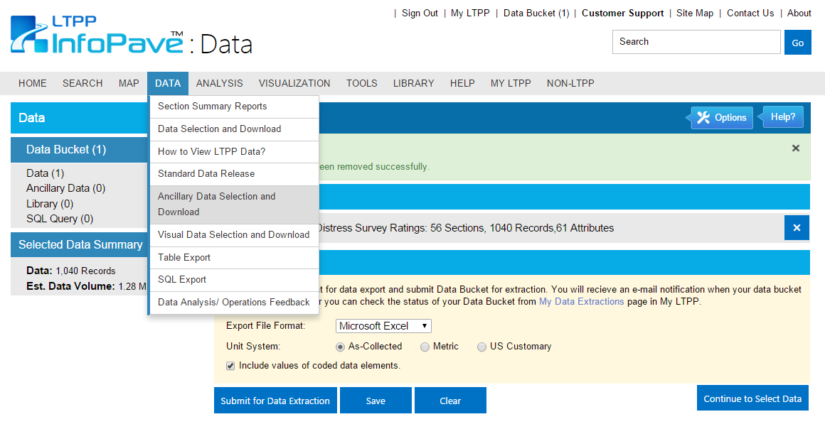
Pavement Distresses: Step 3
http://www.infopave.com/Data/TableExport/
Go to: Data
Go to: Ancillary Data Selection and Download

Slide 10
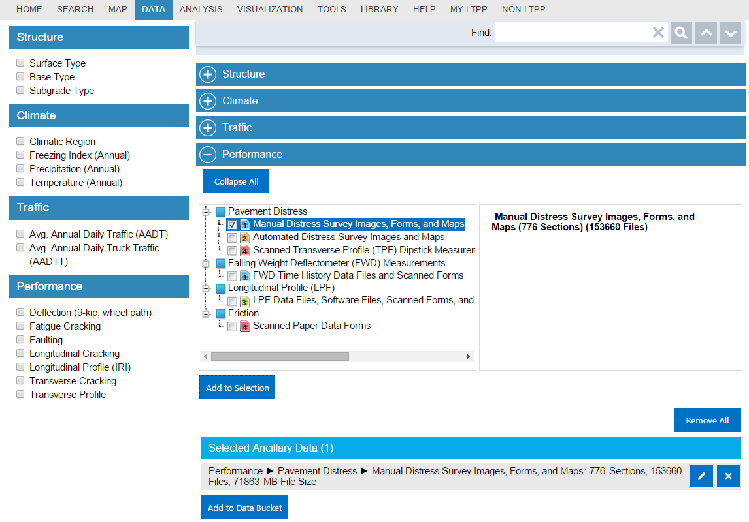
Pavement Distresses: Step 3…
http://www.infopave.com/Data/AncillaryDataSelection
Expand “Performance” tab and select Manual Distress Survey
Click “Add to Selection”
Click “Add to Data Bucket”

Slide 11
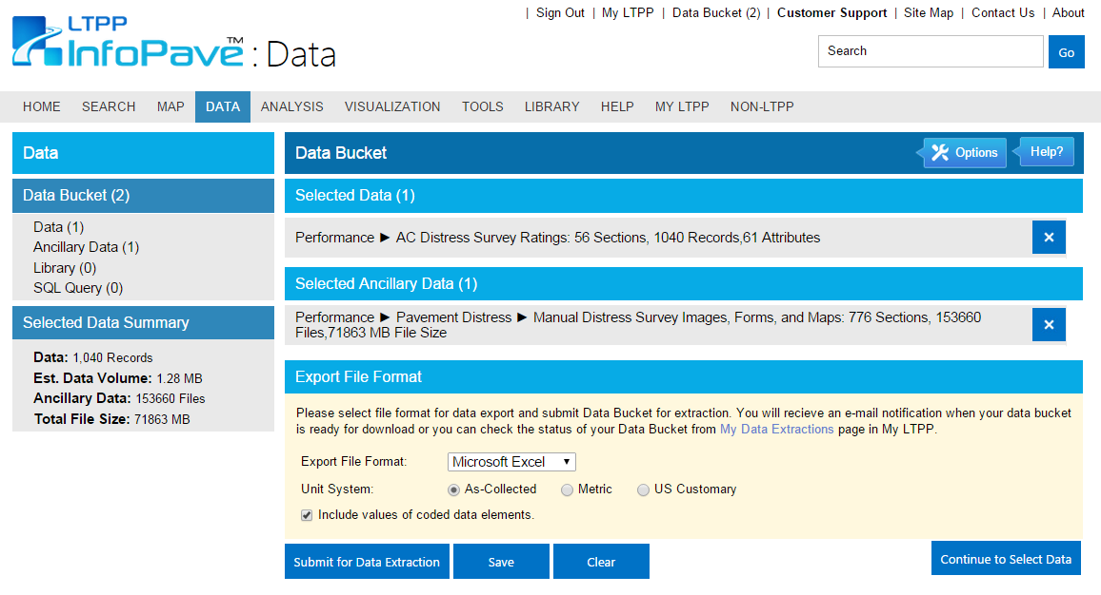
Pavement Distresses: Step 4
www.InfoPave.com/DataBucket/DataBucket
Select preferred export format.
Click “Submit for Data Extraction”

Slide 12
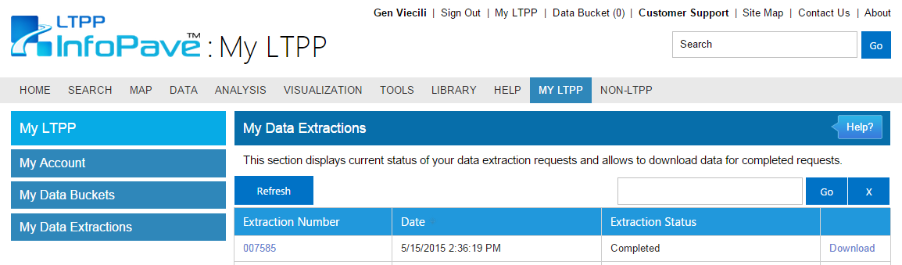
Pavement Distresses: Step 5…
www.InfoPave.com/MyLTPP/MyDataExtraction
Go to: My LTPP
Go to: My Data Extractions
Download & Compile given data.

Slide 13
Pavement Distresses
Results:

Slide 14
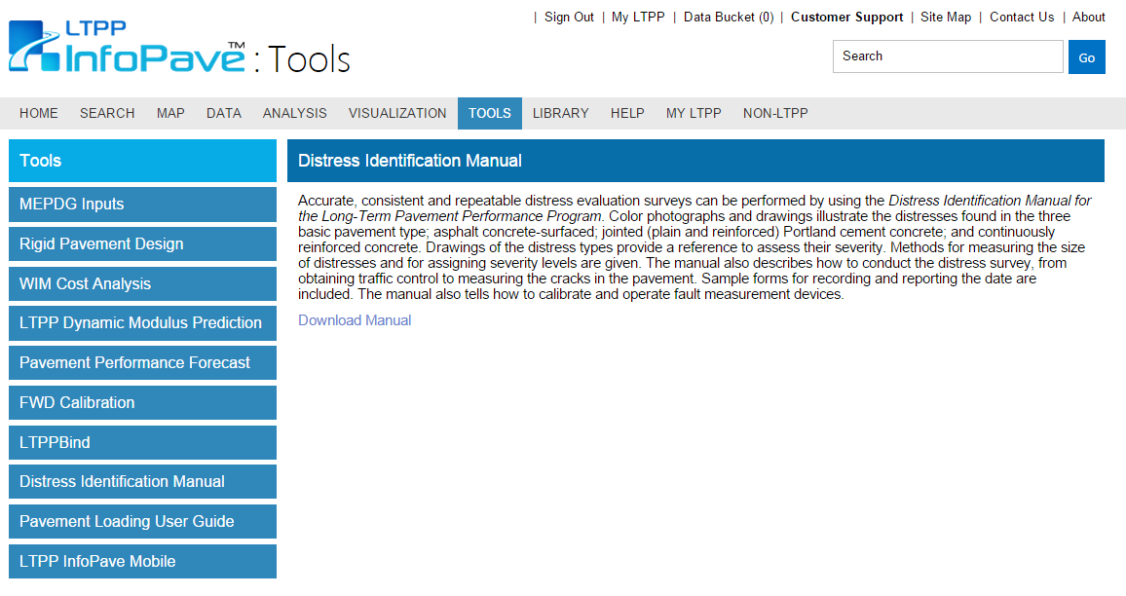
LTPP Pavement Distress Manual
http://www.infopave.com/Page/Index/LTPP_DIM_TOOL
Go to: Tools
Go to: Distress Identification Manual
Download

Slide 15
LTPP Pavement Distress Manual

Slide 16
Questions?

Slide 17
References
Patrick Leong, Susan Tighe, Guy Doré. Using LTPP Data to Develop Spring Load Restrictions: A Pilot Study. Paper Submitted to AISIM, Waterloo, Ont., August 2005
Long Term Pavement Performance. LTPP InfoPave. www.infopave.com.

